Slide 1

Stock Prediction Using News Headlines
MBA 576 Group Project
Spring 2025
Bruno Trautsch
Joe Girard

Slide 2
Agenda
Problem Definition
Dataset Description
State of the Art
Algorithmic Solutions
Performance vs S&P 500
Data Leakage Lessons Learned
Future Research Suggestions

Slide 3
Problem Definition
Can we build a machine learning model that can use natural language processing on news headlines to predict stock price movement?

Slide 4

Dataset Description
Headline data and stock price data (kaggle)
Jan 1, 2010 – Dec 31, 2016
Merged prices with headlines;
For each stock on each day:
Previous day close
Trading day close
Previous days headline

Slide 5
State of the Art
Natural Language Processing
Convert headlines into high-dimension vectors (one dimension per vocabulary word): TF-IDF Vectorizing
Develop classification models to learn class labels based on finding separation between vectors
Test model with unseen headlines to determine ability to generalize on new data
Notes:
TF-IDF = Term Frequency-Inverse Document Frequency

Slide 6
Algorithmic Solutions
Data Pre-processing​
Convert all text to lowercase, remove stopwords and punctuation, and lemmatize
Initially tried to analyze prior week's headlines to determine stock movement at the first trading day of the week
Adjusted to only daily assessments (earlier headlines were likely already priced into stock)
Dropped rows with no headline information
Considered adding quantitative features but modeling revealed no added predictive value:
Weekly volatility, over/under 52-week moving average
Models evaluated:
Random Forest, Logistic Regression, XGBoost Classifier, Support Vector Machine, Neural Network
XGBoost, SVM, and Logistic Regression performed worse than Random Forest and Neural Networks
Used Random Forest and Neural Network as base models and Logistic Regression as meta-model in stacking
After disappointing F1 accuracy scores, we realized our models did not need to get all predictions correct; instead, our strategy was to select most confident picks and then evaluate cumulative returns based on daily average returns
Prioritizes recall: % of True UP that model predicts

Slide 7

Performance Summary
Selected models compared to cumulative returns of S&P 500

Slide 8
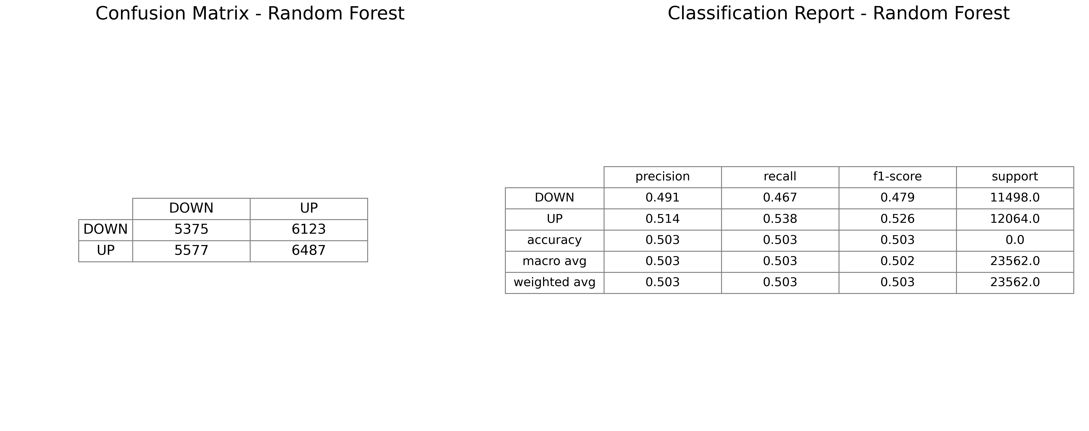

Slide 9
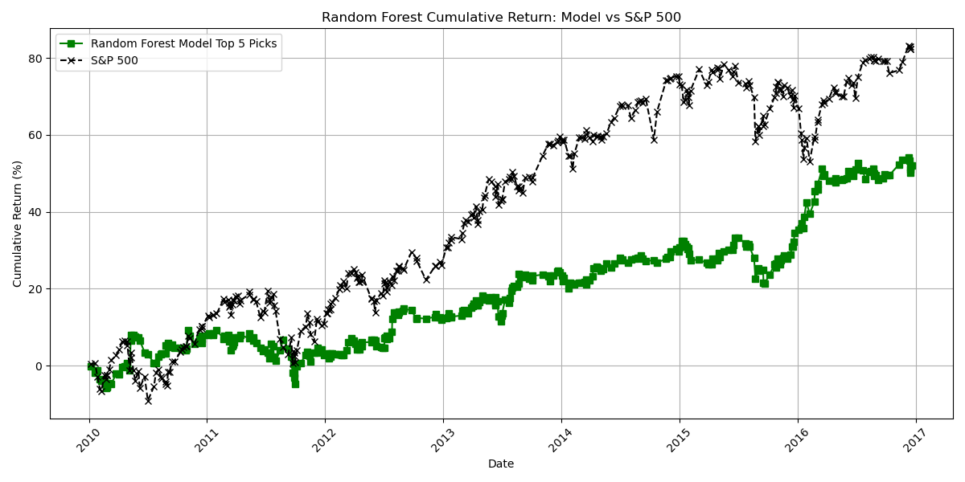

Slide 10
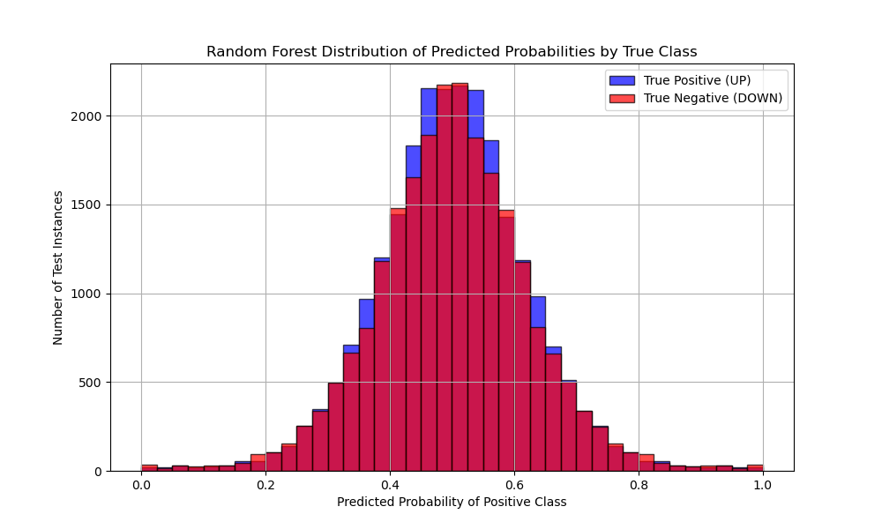

Slide 11
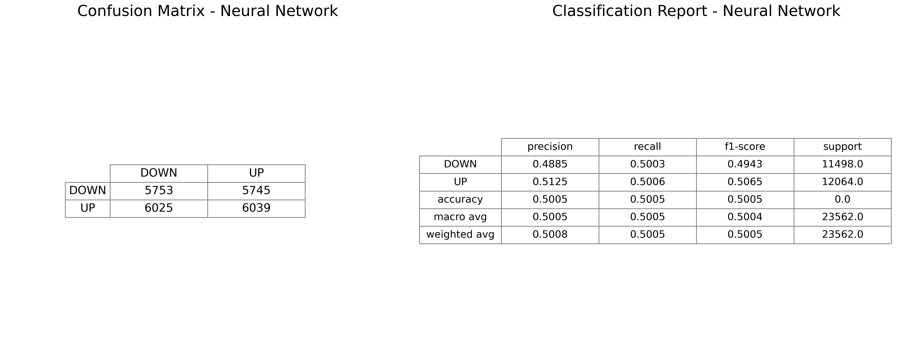

Slide 12
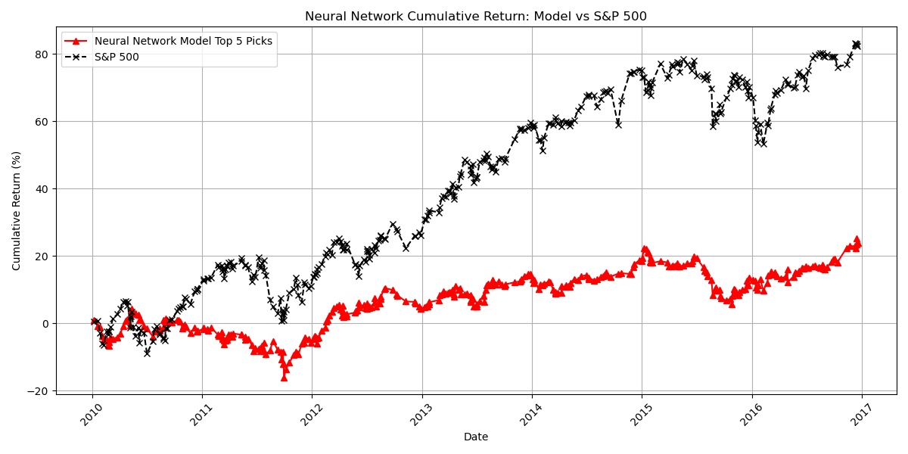

Slide 13
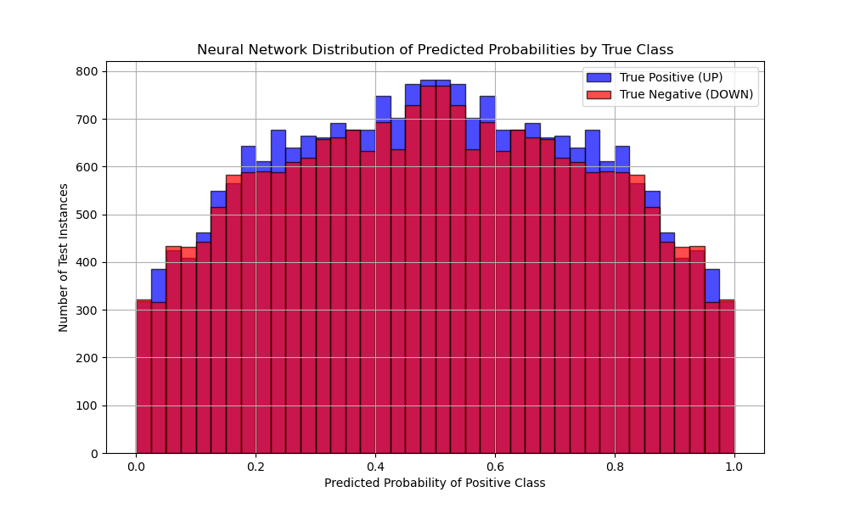

Slide 14
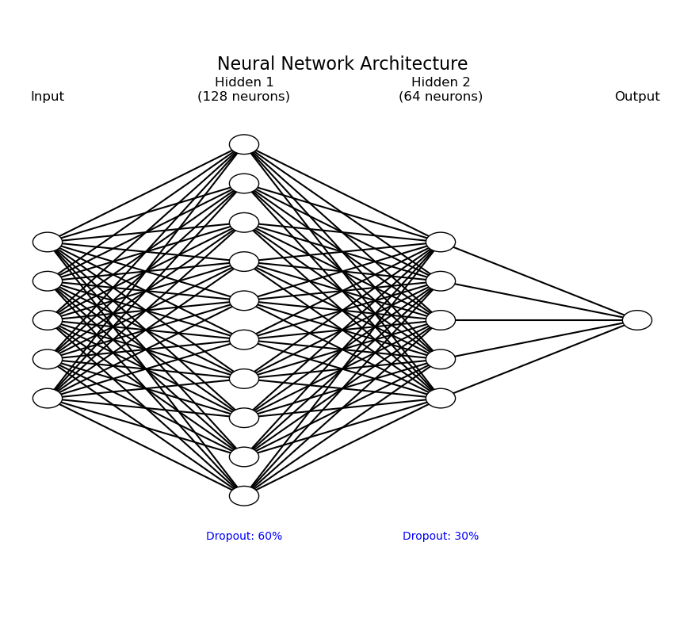
Neural Network Architecture

Slide 15
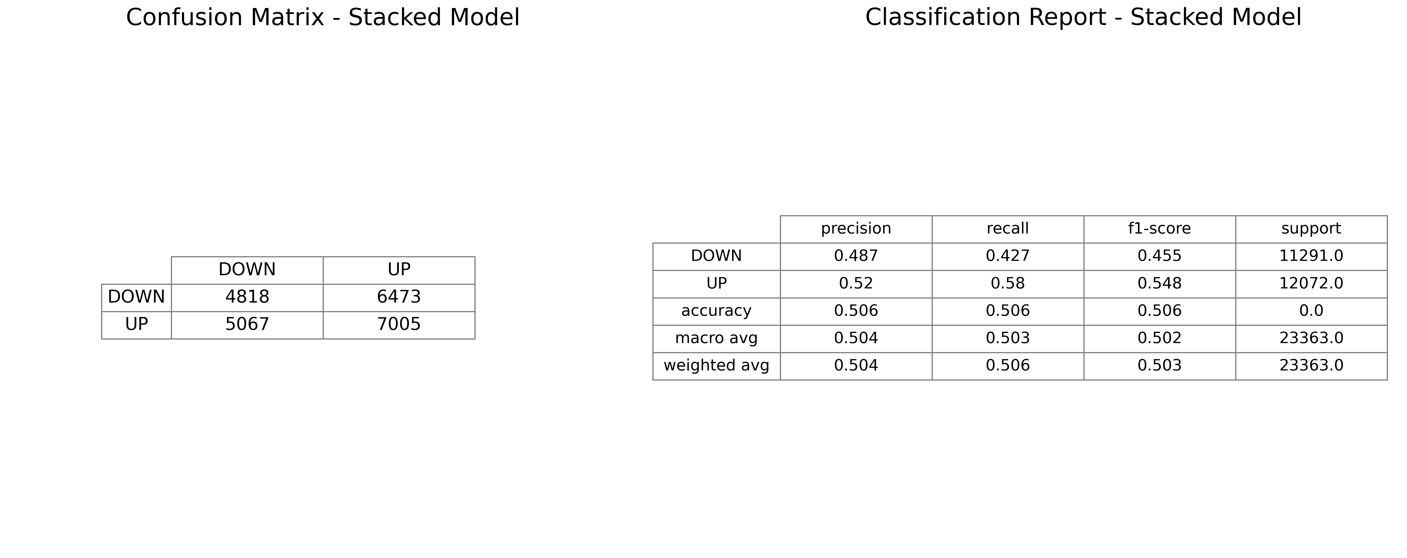

Slide 16
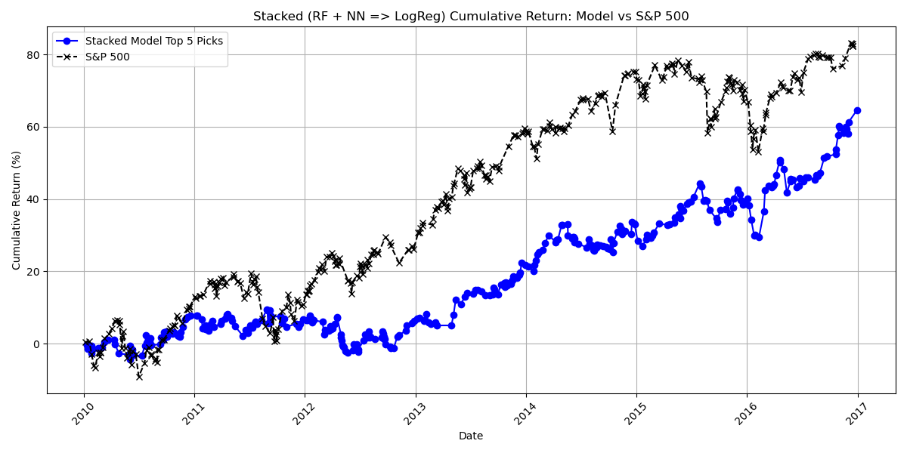

Slide 17
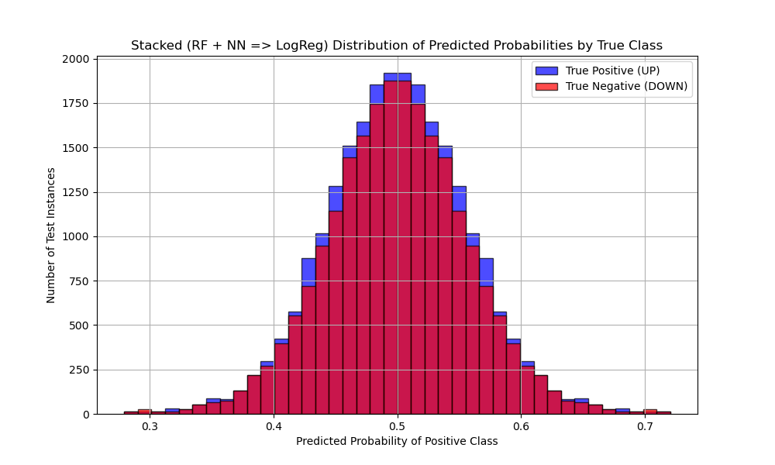

Slide 18
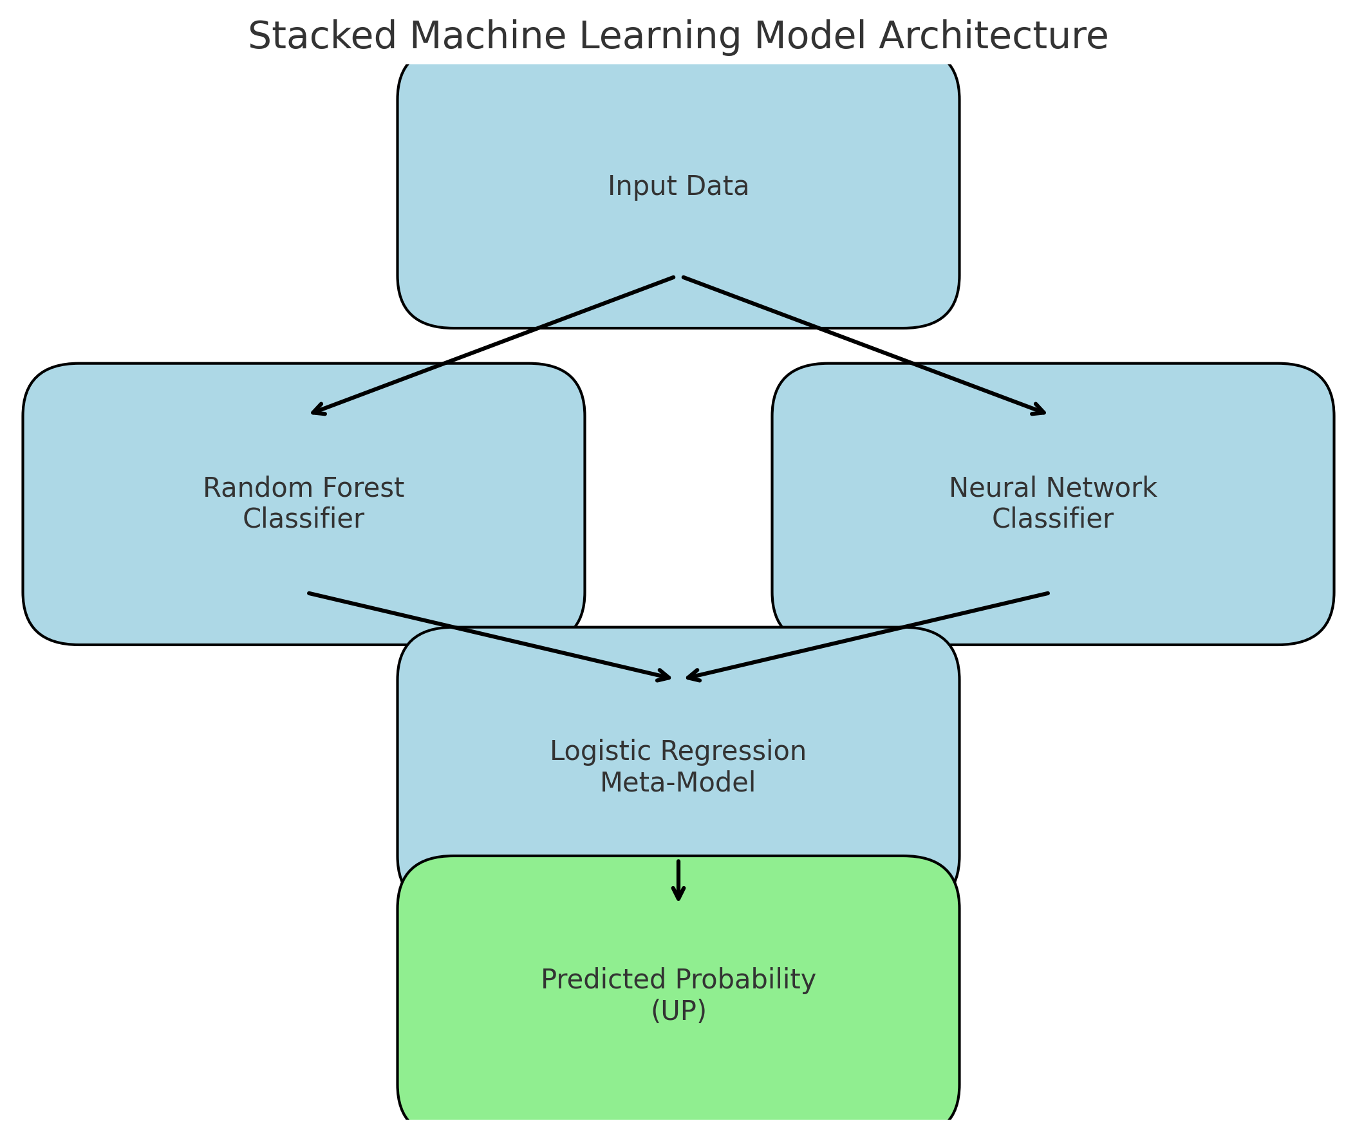
Stacked Model Structure

Slide 19
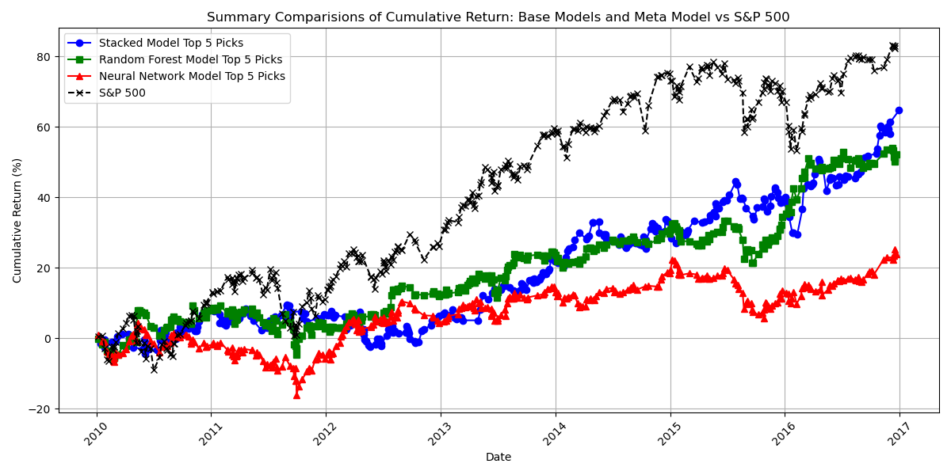

Slide 20
More Models: BERT
precision recall
DOWN 0.51 0.57
UP 0.50 0.44
Accuracy: 0.50
Long training time with 2 epochs
Split up Trainer.predict to use cpu (mpu was crashing)
Normalizing logits could produce confidence to get top picks

Slide 21
Using ChatGPT
System prompt: "You are a financial analyst. Predict if the stock will go UP or DOWN from the news headline. Only answer with UP or DOWN."
Run headline by headline through client.chat.completions with gpt-3.5-turbo (786 rows excluding errors)
No confidence for top picks
Accuracy: 0.5051
Precision Recall
UP 0.4968 0.8000
DOWN 0.5361 0.2219

Slide 22

A Tale of Two Leakages

Slide 23
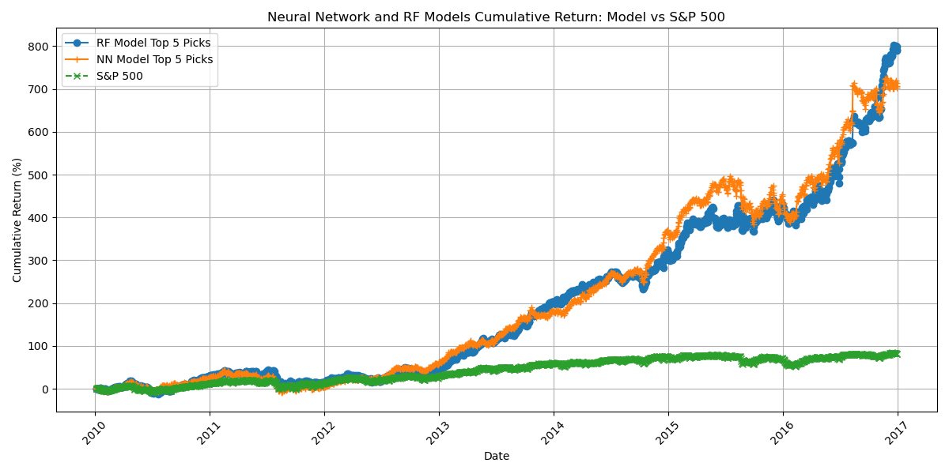
First results: Amazing!
...but too good to be true?

Slide 24
Leakage Issue #1: Headline Text
Train-Test Split randomly split all instances of our merged daily headlines and price data
Did not account for the fact that individual headlines on a given day could apply to multiple stocks
This meant that headline text from the train set was duplicated in the test set
Therefore, when the model read headlines in the test set, it had already seen them (and the actual stock movement) in training
Solution
Trains-Test split needs to happen only on individual days
There can be no date overlap between the train and test splits
This prevents any individual headline from appearing in both sets
This concept was expanded by creating Training, Validation, and Test sets (60%, 20%, 20%) to allow model tuning and stacking without using test data until the final model evaluation

Slide 25
Leakage Issue #2: Vectorizing
Initial draft code to fit TF-IDF Vectorizer to full set of headlines
Done for testing to make sure individual objects worked appropriately
We did not update this usage, and split that data into train and test sets after vectorizing
Therefore, the full TF-IDF vocabulary (including new words in the test set) was available to the model for training
Solution
`fit_transform` on the training set, and then only `transform` on the test set to create headline vectors
By building models using pipelines, we ensured that python handled this automatically
New words in test set headlines became more challenging for the model; predictions based on the parts of the headlines contained in training vocabulary

Slide 26
Conclusion
First, predicting stock price changes is extremely challenging!
Price reflects buying behavior
Buying behavior = macro and micro market factors/forces + human intuition, logic, irrationality
Predictions of this complex cognitive and behavioral pipeline that use weak/noisy headline signals has low accuracy
On reflection, it is remarkable that our various models were partially successful
Second, the benefit of a buy/hold strategy with an index fund is underappreciated
Our charts understate the S&P500 performance by comparing the compounded gains the same as our stick picking model
An S&P 500 index fund with 0.05% annual fee would have returned 125%* over the same period as this analysis
ML and data science fundamentals are critical – data leakage can be difficult to spot and must be accounted for early and often!
* incl. Dividends; 96% w/o dividends

Slide 27

Future Research​
Need more data!
NLP w/ headlines might one of many features to model
Other context-aware NLP methods
Event-driven modeling
Sector-specific context and risk
Quantifiable stock valuation measurements
SEC Filings
Earnings calls tone
Pipeline assessments

Slide 28

Thank you

Slide 29
Post-presentation Updates
Performance summaries of models after properly splitting dataset to preserve time ordering

Slide 30
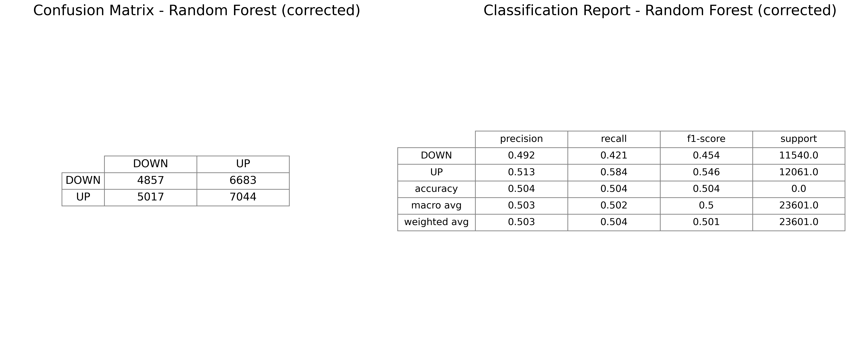

Slide 31
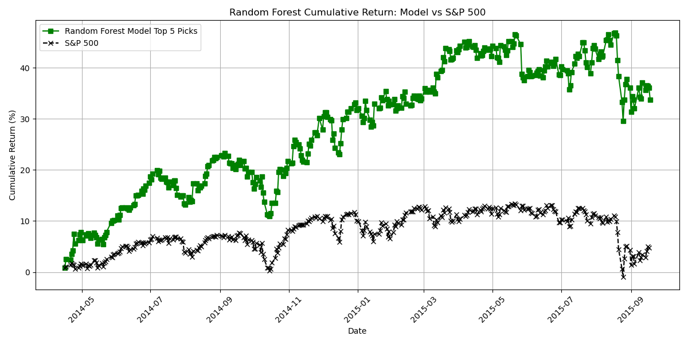

Slide 32
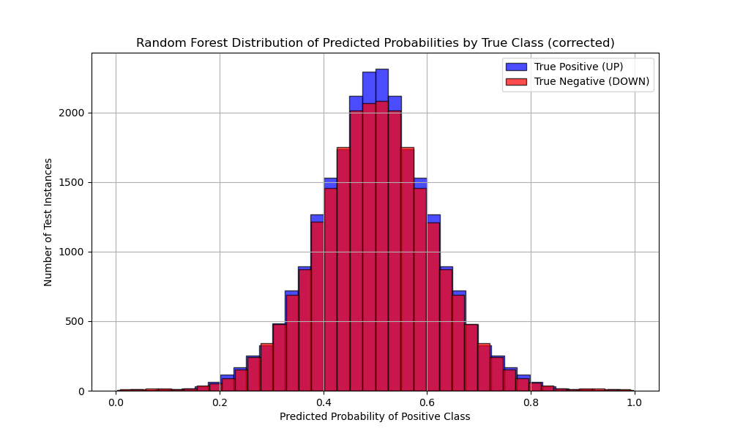

Slide 33
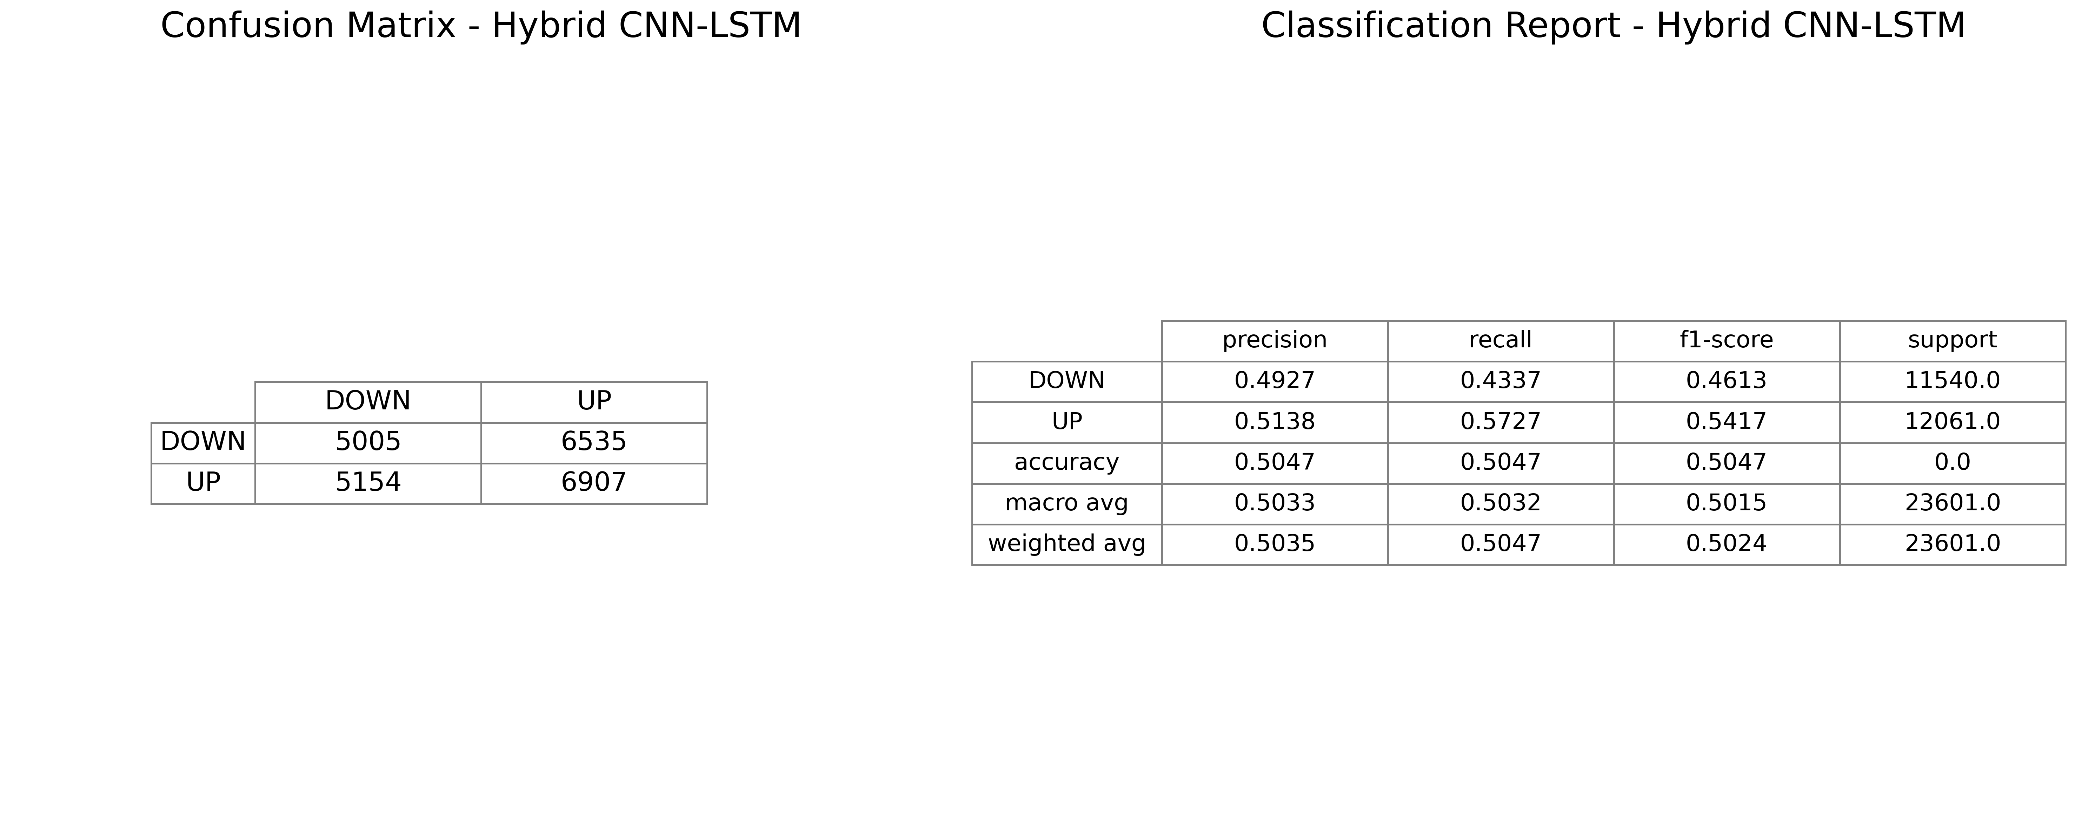

Slide 34
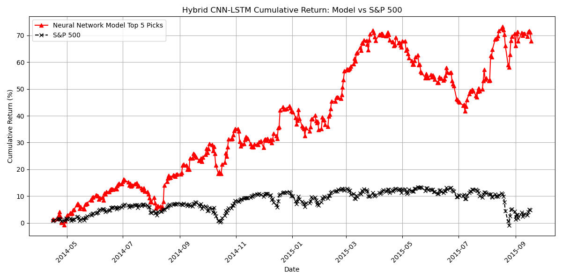

Slide 35
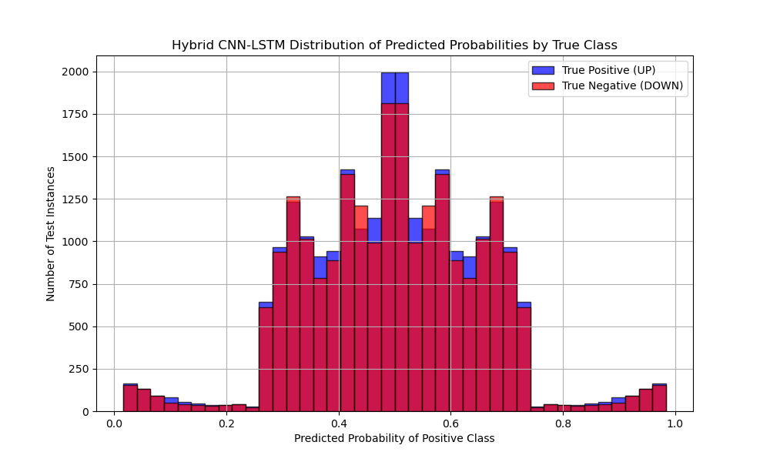

Slide 36
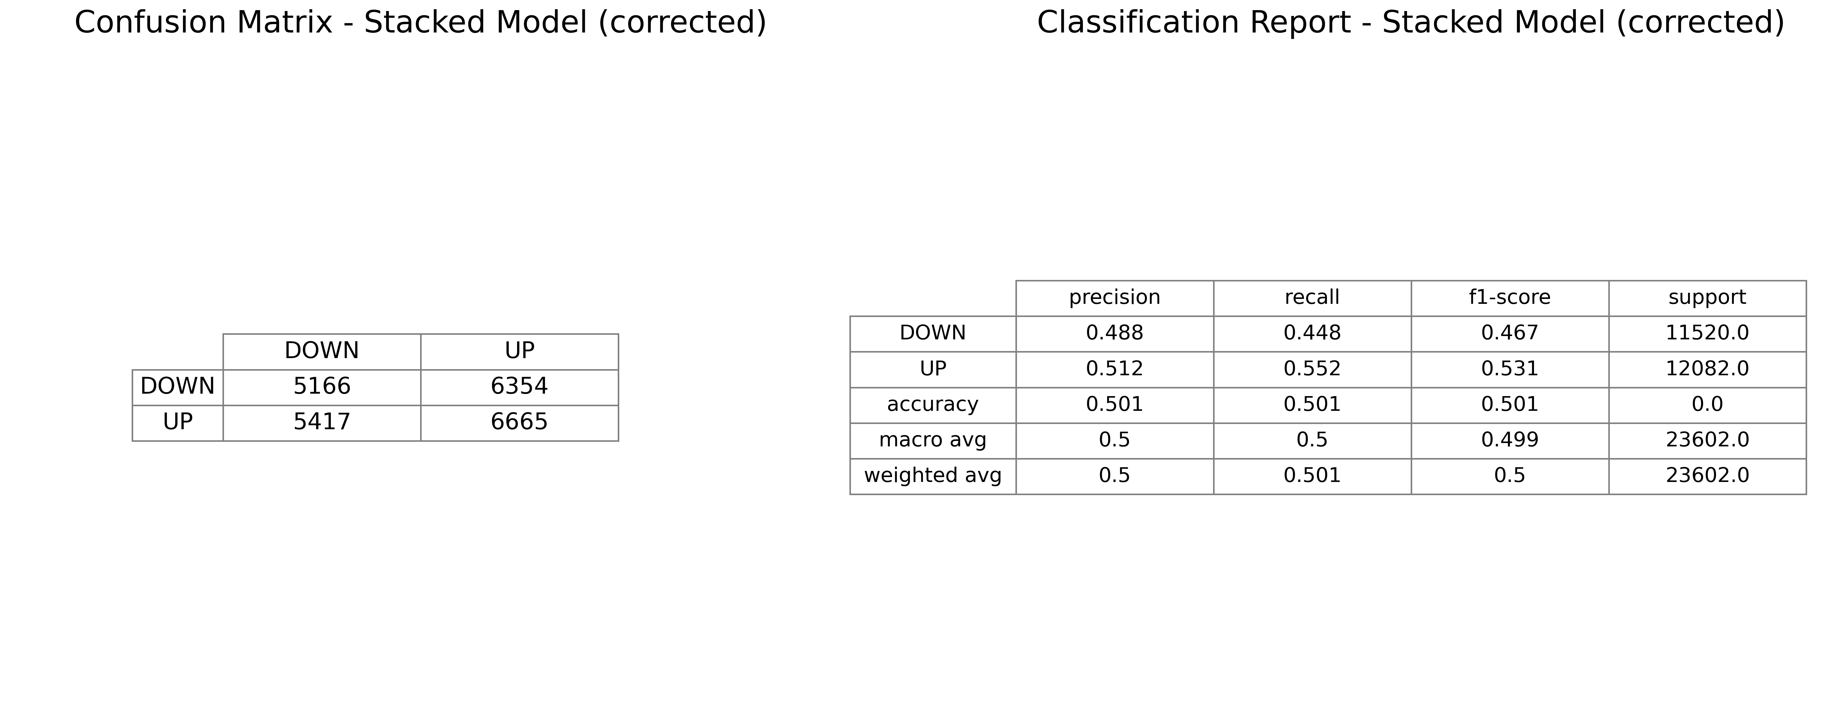

Slide 37
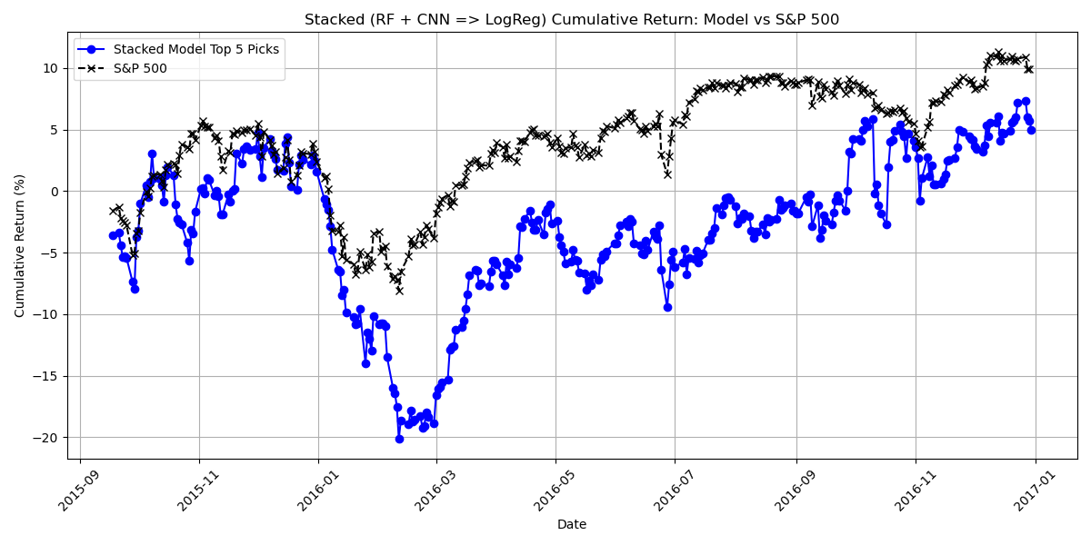

Slide 38
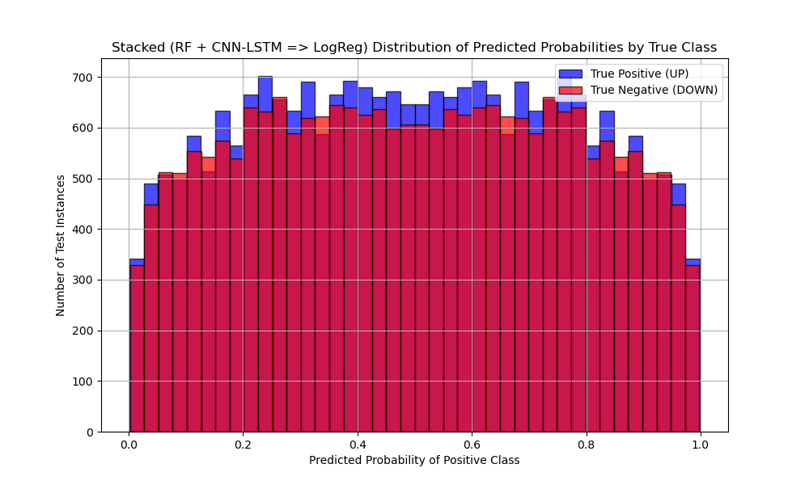

Slide 39
